Slide 1


SMART TRAFFIC DENSITY PREDICTION CCTV-Based Vehicle Detection and Congestion Forecasting using YOLO, CNN & LSTM
SIMATS ENGINEERING
Saveetha Institute of Medical and Technical Sciences
Chennai-602105
Artificial intelligence –csa1711
UNDER THE GUIDANCE BY:
Krishnakumar K
BY:
Shabarish N 192424007
Prince Raj 192312284
J.Sakthivel 192512409

Slide 2
.
Introduction
Rapid urbanization leads to increasing traffic congestion.
Traditional traffic monitoring mainly depends on manual observation.
CCTV cameras provide continuous real-time traffic information.
Machine learning can automatically detect vehicles and predict congestion.
The proposed system combines YOLO, CNN and LSTM for intelligent traffic prediction

Slide 3
.
Problem Statement
Increasing Traffic: Rapid growth in vehicles causes frequent traffic congestion.
Manual Monitoring: Traditional traffic monitoring is time-consuming and less efficient.
Real-Time Detection: There is a need to automatically detect and count vehicles from CCTV footage.
Congestion Prediction: Existing monitoring methods have limited ability to predict upcoming traffic conditions.
Smart Solution: An AI-based system using YOLO, CNN, and LSTM is needed for vehicle detection and short-term traffic density prediction.

Slide 4
LITERATURE REVIEW
S.No | Author & Year | Paper Title | Method Used | Limitations
1 | Chao Wang, Qiang Shang, Kun Liu & Wenxue Zhang (2025) | Traffic Congestion Recognition Based on Convolutional Neural Networks in Different Scenarios | CNN + YOLOv8 | Mainly focuses on congestion recognition; performance can be affected by difficult weather and visibility conditions.
2 | Y. Chen (2025) | YOLO-Based and DCNN Fusion for Urban Traffic Congestion Prediction | YOLO + CNN | Combining multiple deep-learning models increases computational complexity and processing requirements.
3 | Junwoo Lim, Juyeob Lee, Chaehee An & Eunil Park (2024) | Enhancing Real-Time Traffic Volume Prediction: A Two-Step Approach of Object Detection and Time Series Modelling | YOLOv7 + LSTM | Mainly focuses on traffic-volume prediction; longer-term prediction requires further improvement.
4 | Kranti Kumar, Manoj Kumar & Pritikana Das (2024) | Traffic Congestion Forecasting Using Multilayered Deep Neural Network | CNN + LSTM | Dataset was collected from a limited location and time period, reducing generalization to different traffic environments.
5 | Ganapathy Sannasi & Devansh Ajmera (2024) | An Intelligent Video Surveillance System for Detecting the Vehicles on Road Using Refined YOLOv4 | YOLOv4 | Mainly performs vehicle detection and tracking and does not focus on predicting future traffic congestion.

Slide 5
AIM AND OBJECTIVES
Aim
To design a Smart Traffic Density Prediction system that analyzes CCTV images and forecasts traffic congestion in real time.
Objectives:
To Collect and preprocess CCTV-based traffic data.
To Detect and count vehicles using YOLO.
To Extract spatial features using CNN.
To Predict short-term congestion using LSTM.
To Evaluate using RMSE and prediction accuracy.
To Display results through an interactive dashboard.

Slide 6
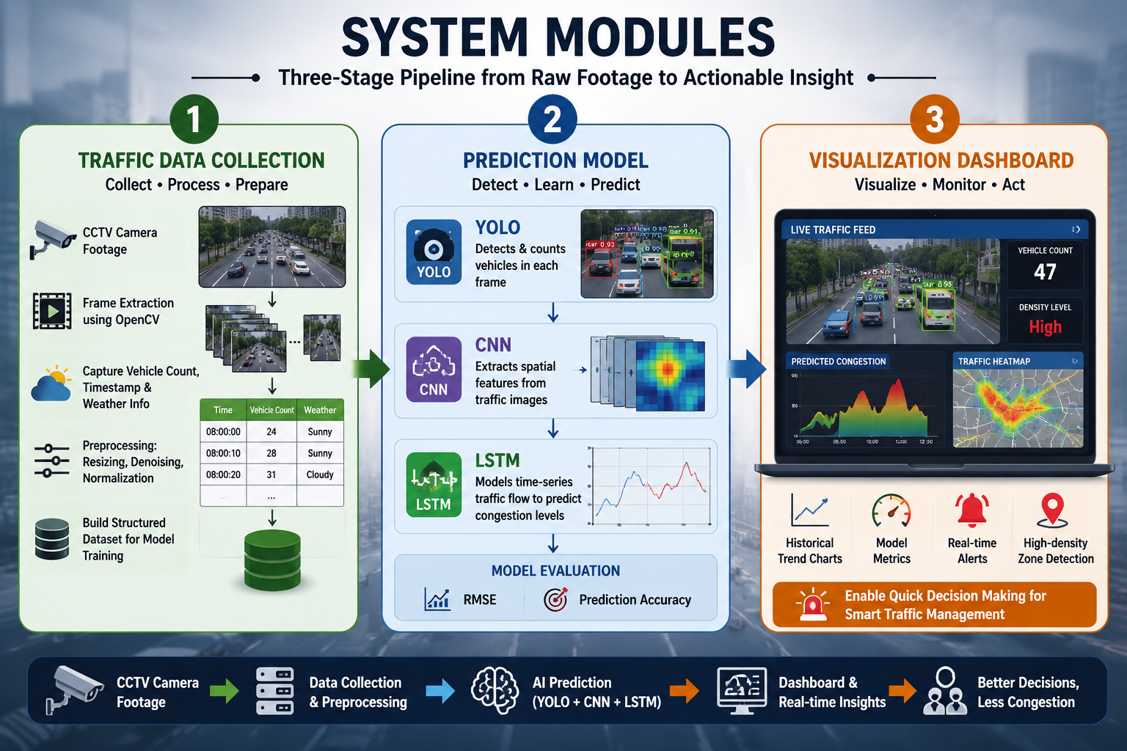

Slide 7
Module 1- Traffic Data Collection & Preprocessing
Capture real-time traffic footage using CCTV cameras.
Extract individual frames from video using OpenCV.
Resize frames to a suitable resolution.
Apply image preprocessing and normalization.
Remove noise and improve image quality.
Record vehicle count and timestamp information.
Collect relevant weather conditions.
Prepare and store the processed data for the prediction model.

Slide 8
Module 2 - Traffic Prediction Model
Apply YOLO for real-time vehicle detection.
Identify different vehicle types such as cars, buses, bikes, and trucks.
Calculate the vehicle count from each frame.
Use CNN to extract important spatial features.
Combine vehicle count with time and weather data.
Use LSTM to learn traffic patterns over time.
Predict upcoming traffic density and congestion levels.
Evaluate prediction performance using RMSE and prediction accuracy.

Slide 9
Module 3 - Visualization Dashboard
Display the live CCTV traffic feed.
Show detected vehicles with bounding boxes.
Display the current vehicle count.
Show the current traffic density level.
Display predicted congestion levels.
Present historical traffic trends.
Provide alerts for high-density areas.
Support traffic authorities in real-time decision-making.

Slide 10
WORKFLOW
CCTV Camera → OpenCV → YOLO → CNN → Vehicle Count + Time + Weather → LSTM → Prediction → Dashboard
Performance Metrics:
RMSE: Measures prediction error.
Prediction Accuracy: Measures how accurately congestion levels are predicted.

Slide 11
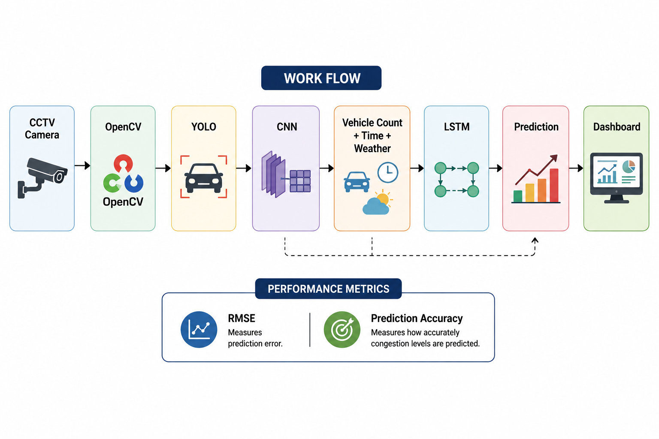
.

Slide 12
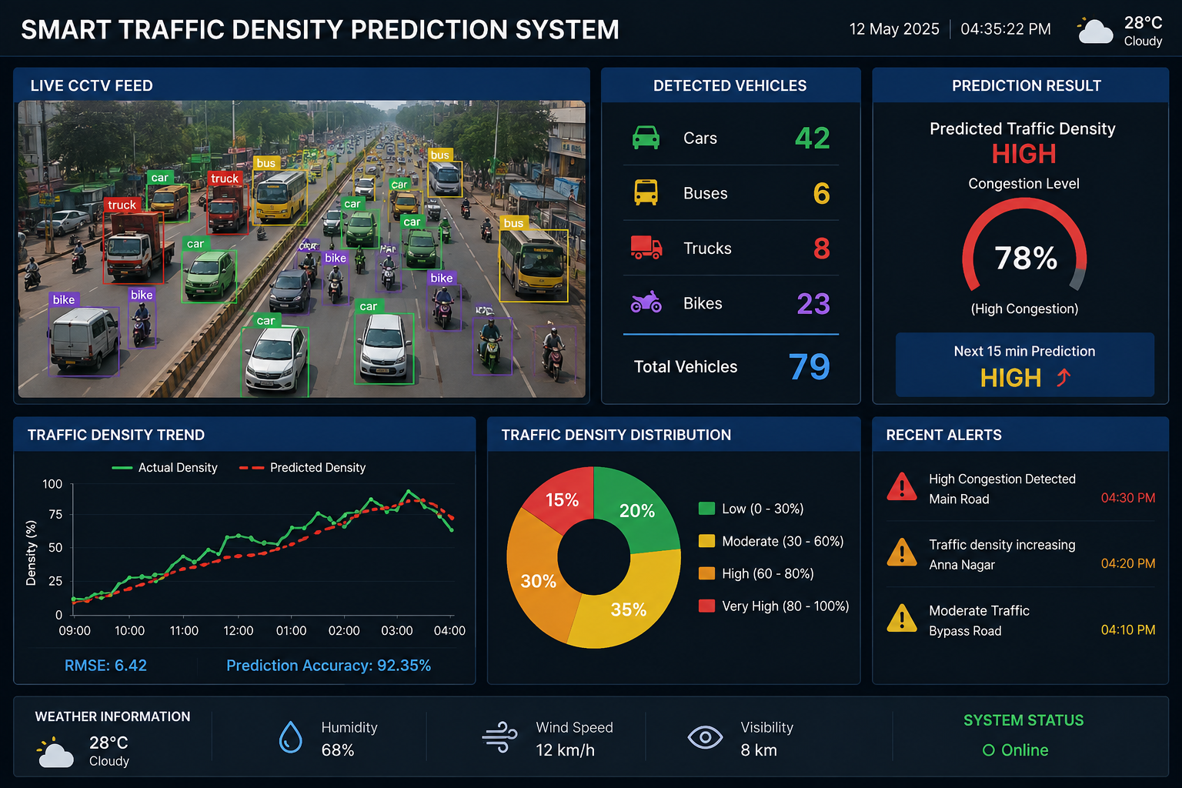
Sample Output of the Project
.

Slide 13
.
RESULT AND ADVANTAGES
Accurate Vehicle Detection – YOLO detects and counts vehicles from CCTV footage.
Effective Feature Extraction – CNN identifies important features (edges patterns shapes) traffic patterns.
Congestion Prediction – LSTM predicts short-term traffic congestion levels.
Real-Time Monitoring – The dashboard provides live traffic information and predicted congestion.
Better Traffic Management – The system enables early congestion identification and supports faster decision-making

Slide 14
CONCLUSION
The system provides automated traffic monitoring using CCTV.
YOLO enables vehicle detection and counting.
CNN extracts useful features traffic features.
LSTM predicts short-term congestion patterns.
The dashboard supports real-time traffic management and decision-making

